Slide 1
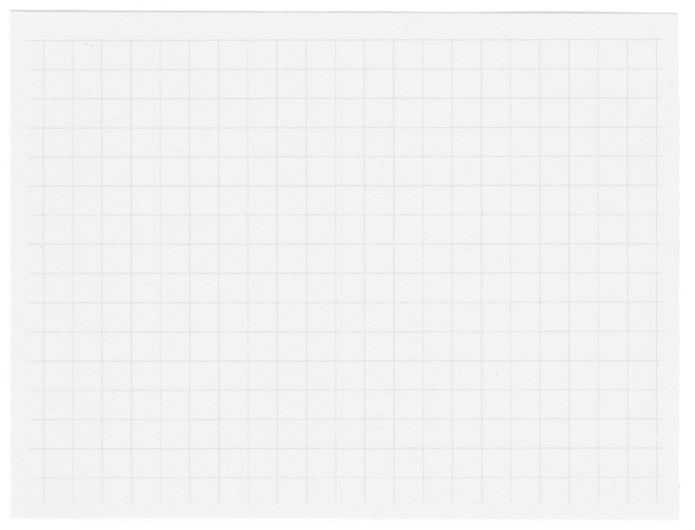













RoomM8
Shared Living made Simple
Presented by Group 7

Slide 2
01.
Overview
02.
Features
Table of Contents
Mock up pages
03.
04.
Work Flow
05.
Technologies
06.
Milestone

Slide 3
Living in a shared space with roommates can often lead to challenges in managing and splitting expenses, as well as keeping track of shared responsibilities. Our Roommate Expense and Task Management Application aims to simplify and streamline these processes, making communal living more organized and stress-free.
Why?

Slide 4
Enhanced Communication
Convenience
Makes management easier
Reduce Conflicts
Reminders
Overview

Slide 5
Friends
Students
Temporary Residents
Family Members
Anyone living in a shared Accomodation
Target Users

Slide 6
Features

Slide 7

Authentication
Announcements
Login: Secure user login with email and password, or social media integration.
Sign Up: User registration process with input validation and account verification.
Forgot Password: Secure password reset functionality with email-based password recovery.
Encryption
Create : Announcements with titles, descriptions, and attachments.
View : announcements and their associated content.
Edit : Existing announcements by updating their details.
Remove : outdated or irrelevant announcements from the shared space.
Room Setup
Shared Documents/Photos
Mnemonic room codes for easy remembering and sharing.
Unique room identifiers for distinguishing shared spaces.
Upload document/photo.
View and access documents/folders.
Delete documents/photo.

Slide 8
Grocery List
Expenses
Add grocery item to a common grocery list with quantity and notes.
Able to modify the grocery item details.
Delete grocery item from the common grocery list.
Split bills paid by single roommate among multiple roommates.
Keep track of who owes who.
Settle up with a roommate by recording payment.
Tasks List
Email
Assign tasks among roommates with a deadline and description.
Modify task and edit the task details.
Delete task once it is completed.
Sends email whenever the alert is urgent.
Sends email to the person to whom a new task has been assigned.

Slide 9
Mockup Pages

Slide 10
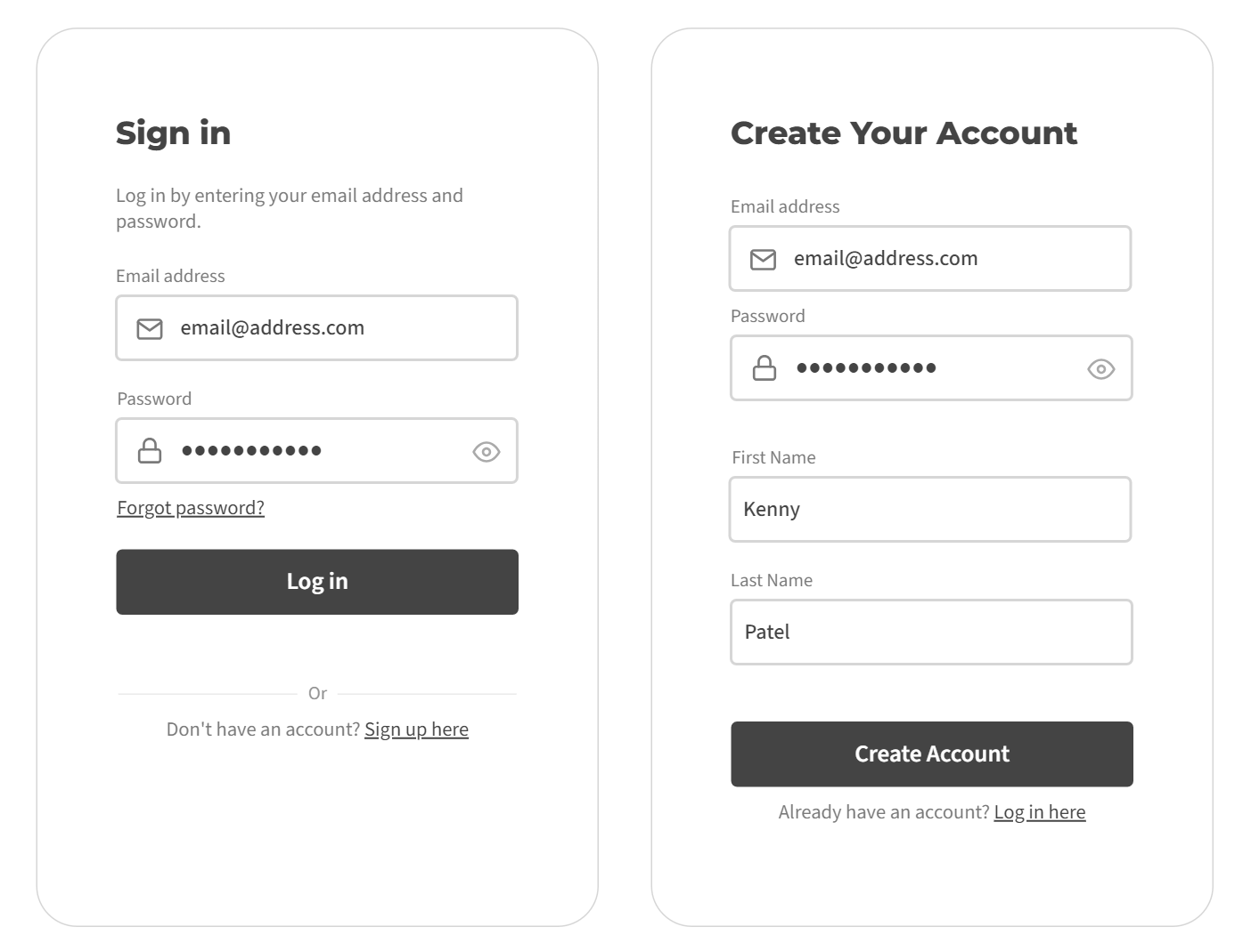
Login / Signup

Slide 11
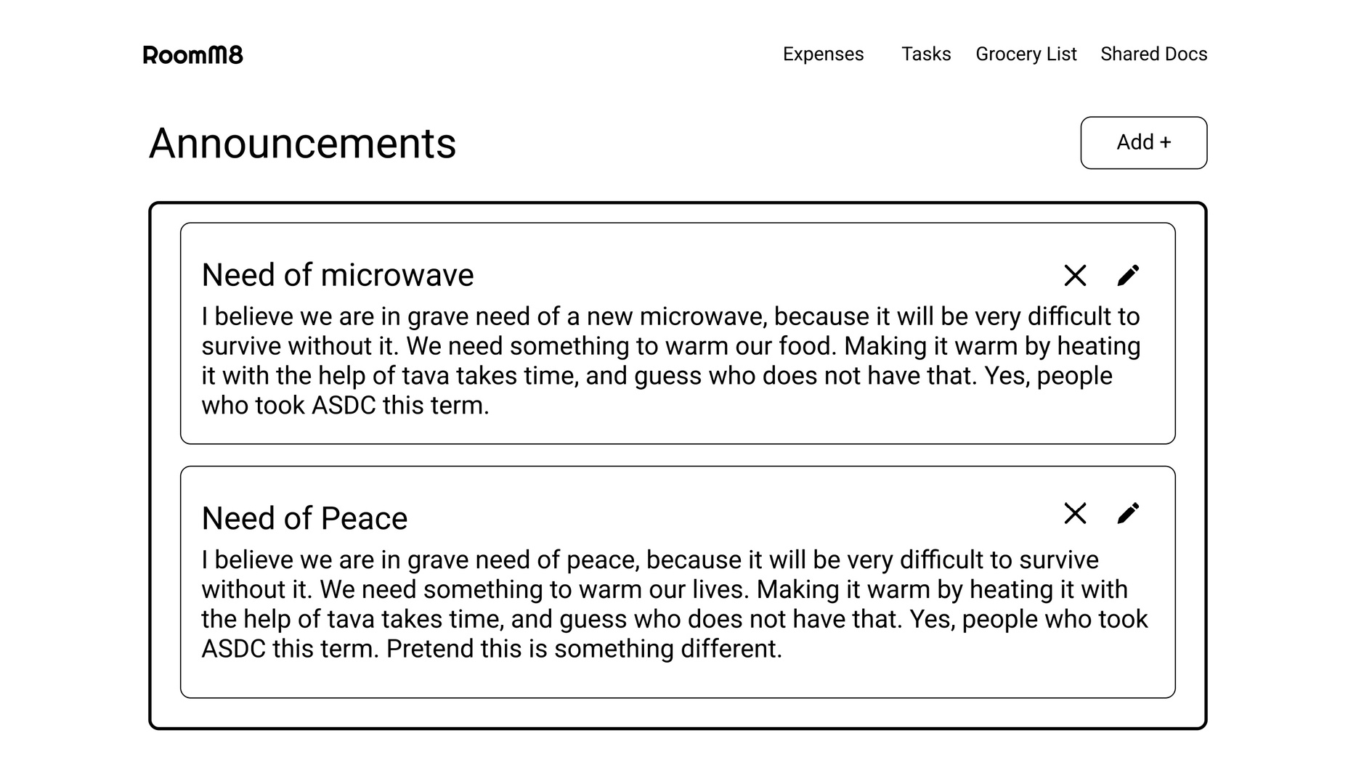
Home Page

Slide 12
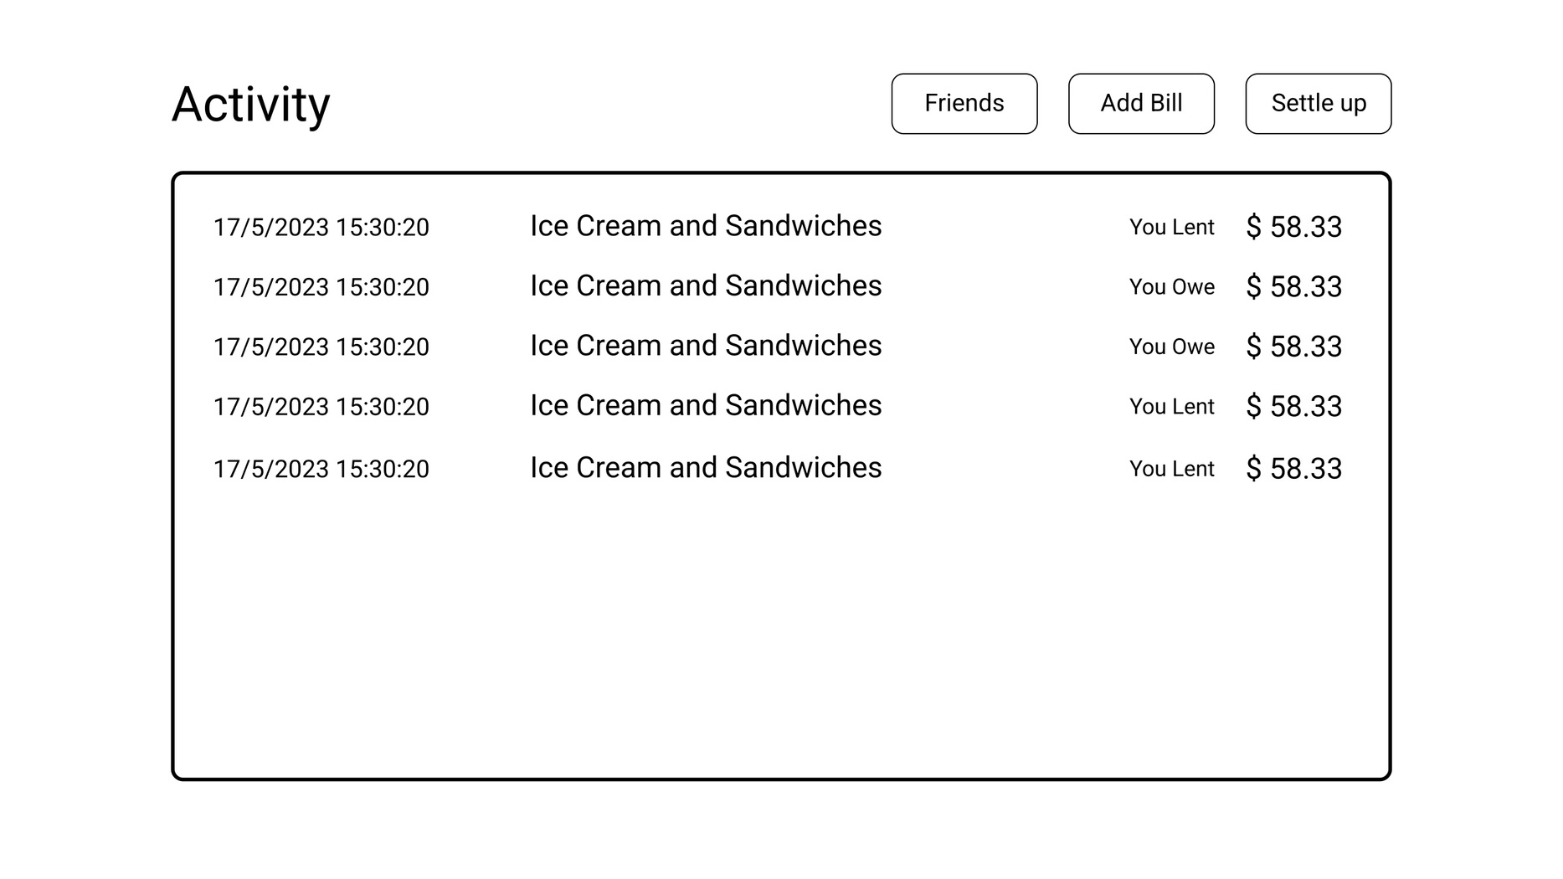
Expense Page

Slide 13
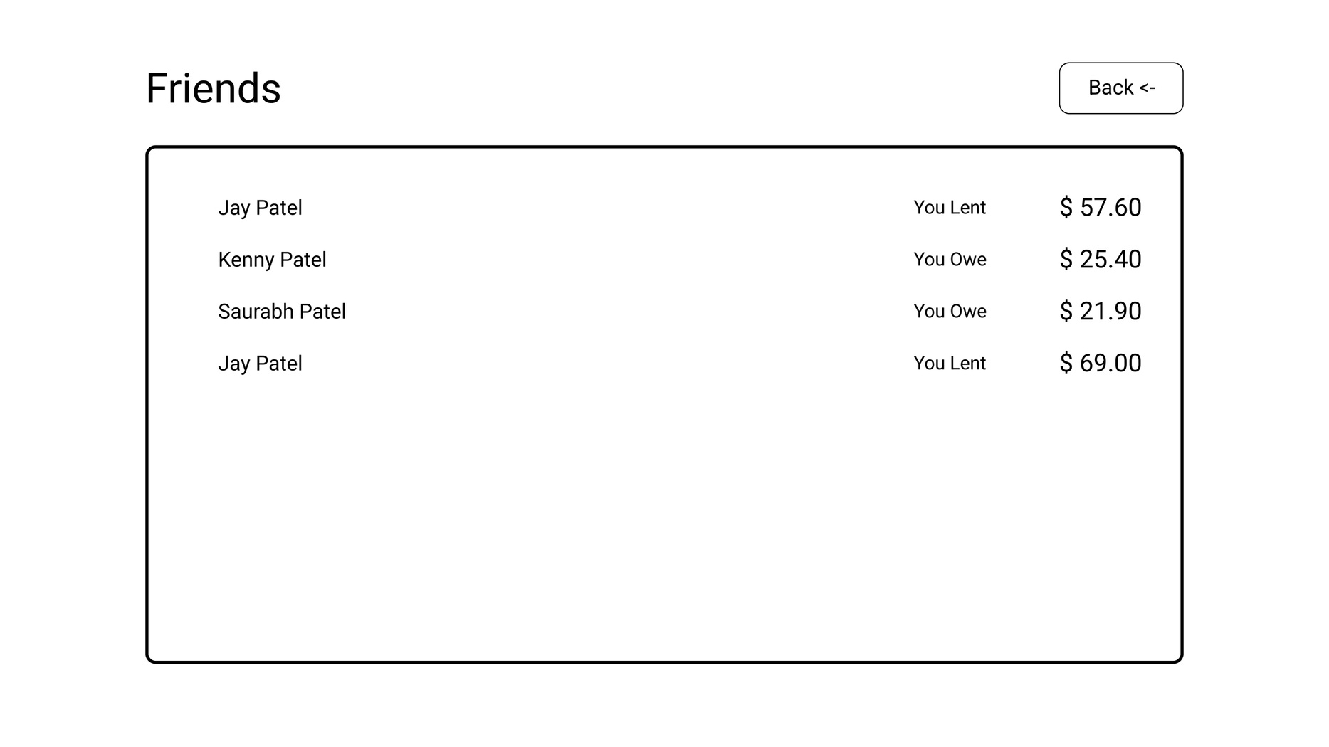
Friends Page

Slide 14
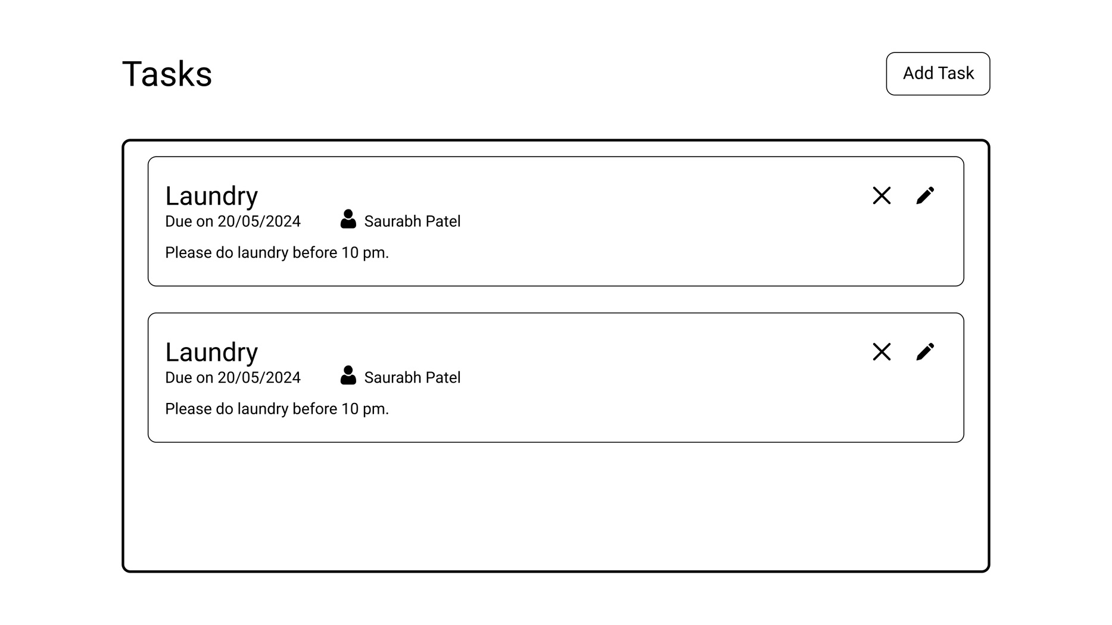
Task List Page

Slide 15
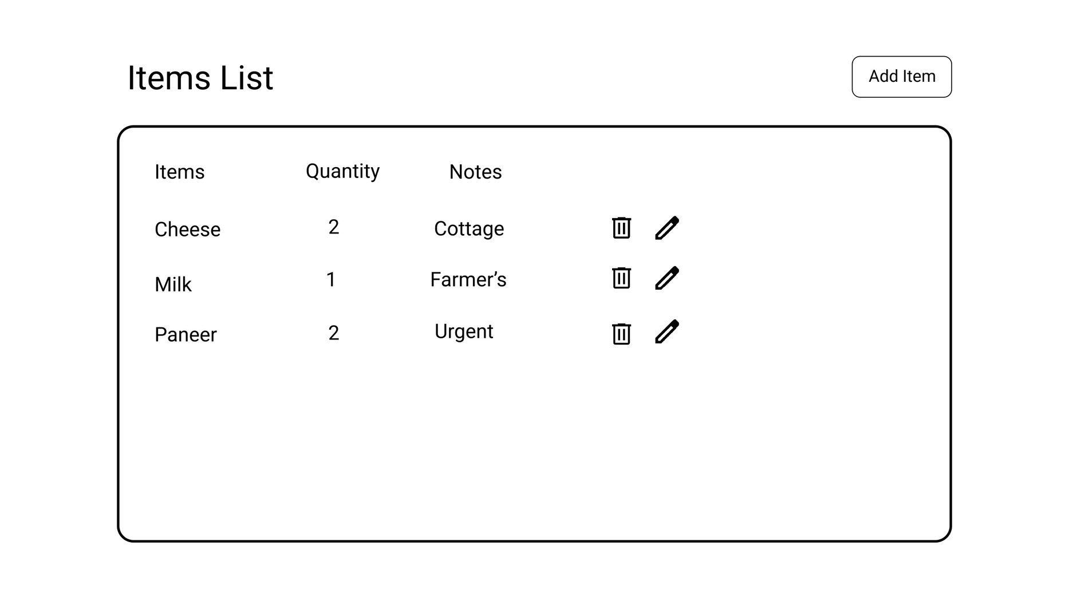
Grocery List Page

Slide 16



Technologies
Next.js / React
Tailwind CSS
It offers out of box Server Side Rendering (SSR) improving performance.
React can be used to develop single-page, mobile, or server-rendered applications with frameworks like Next.js.
Provides Fast refresh for faster development.
It provides low-level utility classes to build custom designs directly in HTML.
It simplifies styling by avoiding traditional CSS methods and instead uses predefined classes.
Helps with rapid and highly customizable development.

Slide 17


Technologies
SpringBoot
MySql
Seamless integration with MySql database and efficient data transfers.
It has Modular Architecture and easy to scale.
It has amazing ecosystem and good community support and resources.
It offers efficient handling of structured data.
It can handle large datasets, supports horizontal scaling.
Various side tools focused on creating good development experience.

Slide 18
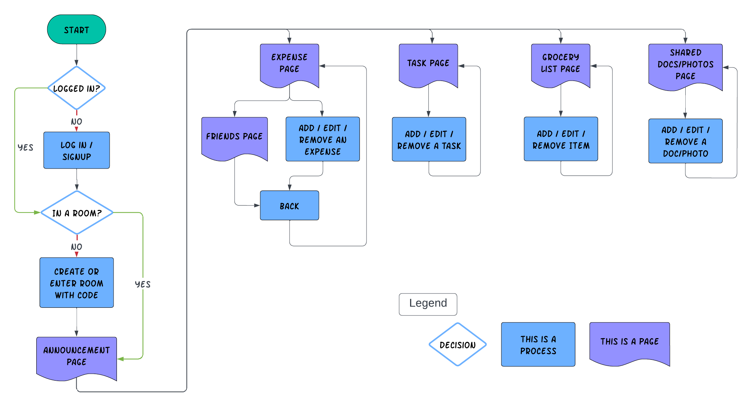
Work Flow

Slide 19
Milestones
25 %
01
02
03
Requirement gathering & Data modeling
Authentication, Home Page & CI/CD
Grocery List, Task List & Room Setup

Slide 20
Milestones
50 %
75 %
100 %
04
05
06
Announcements & Alerts
Expense Tracking
Shared Photos & Documents

Slide 21
Thank you very much!

